Slide 1
Machine Learning Classification

Slide 2
Classification
Unlike regression where you predict a continuous number, you use classification model to predict a category
Logistic Regression
K-Nearest Neighbors (K-NN)
Support Vector Machine (SVM)
Kernel SVM
Naive Bayes
Decision Tree Classification
Random Forest Classification

Slide 3
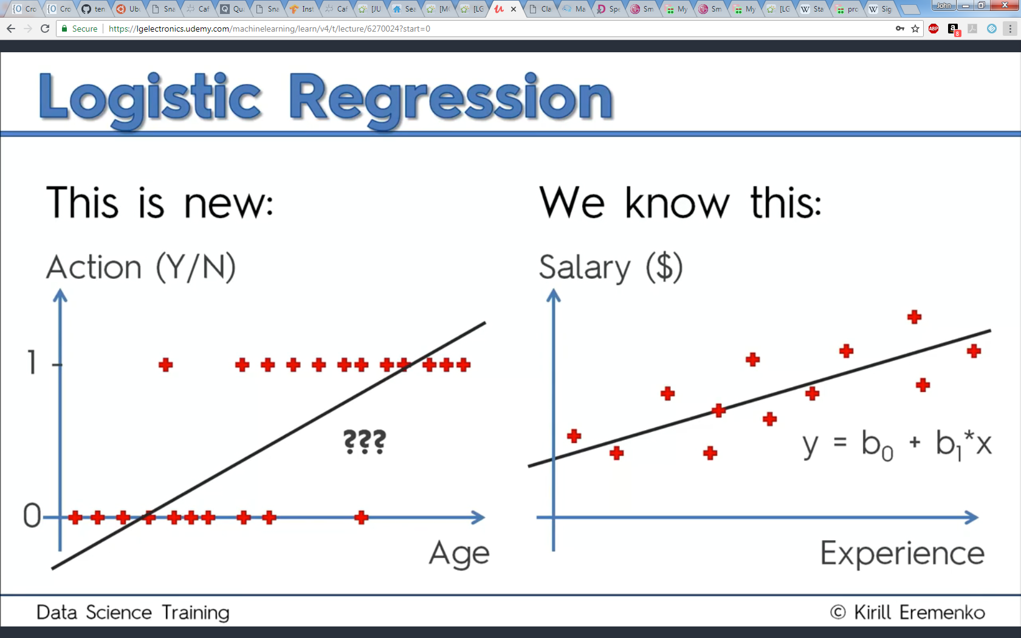
Logistic Regression
Can a straight line fit ‘categorical’ data well as it did for regression?

Slide 4
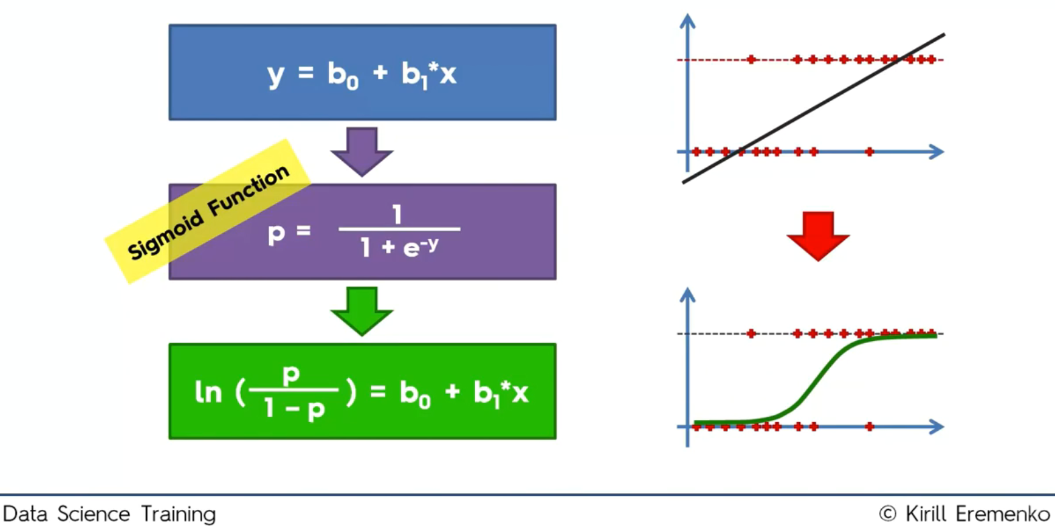
Logistic Regression
Logical regression, sigmoid function, fits better

Slide 5
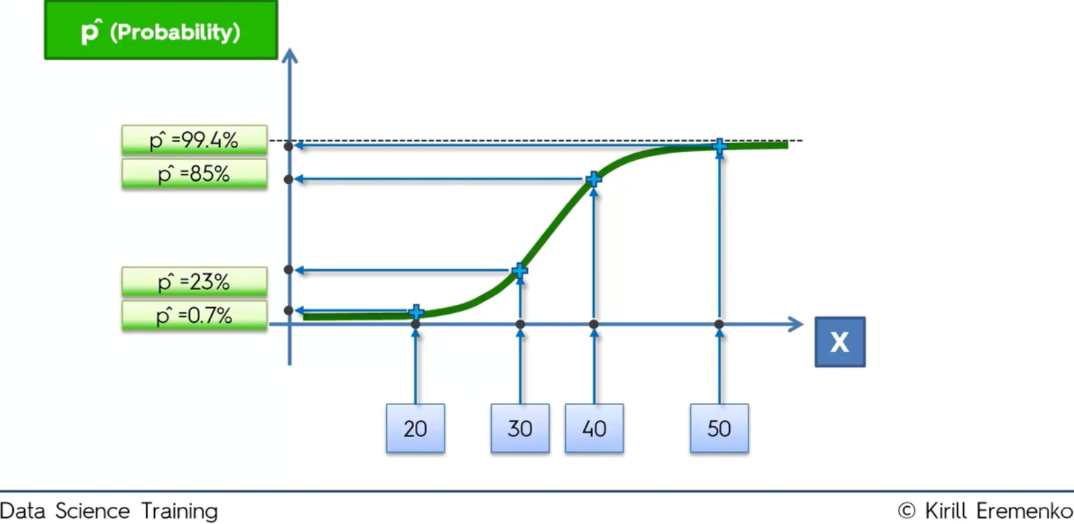
Logistic Regression
Sigmoid curve returns probability at X

Slide 6
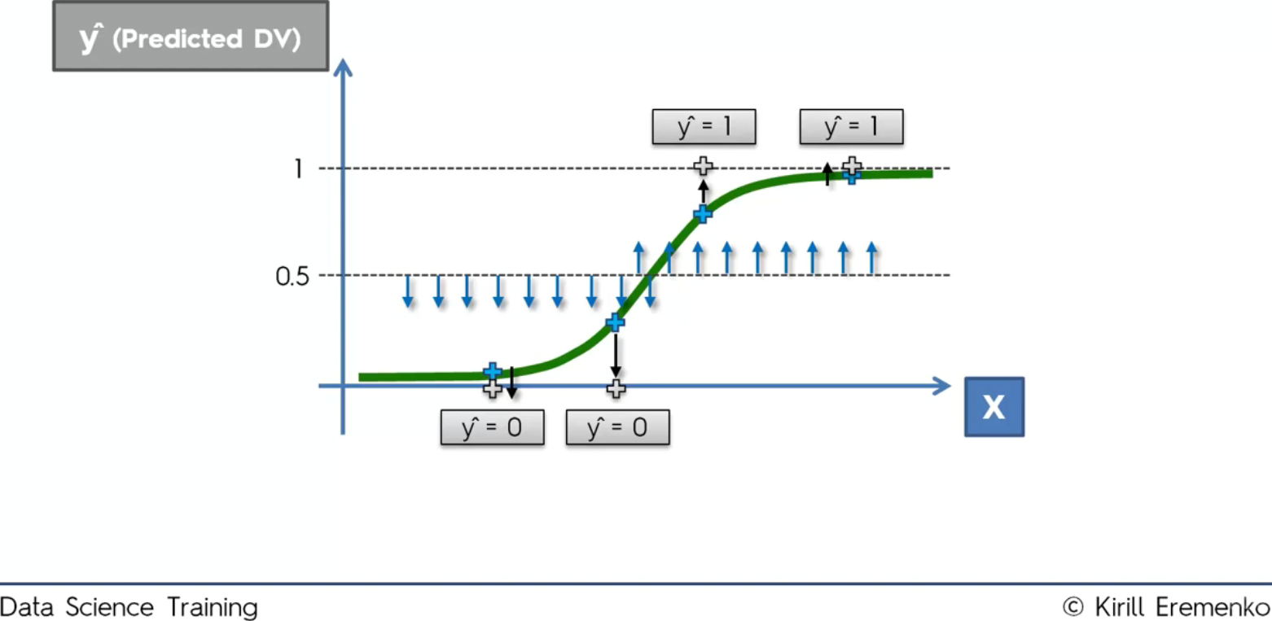
Logistic Regression
Make categorical prediction based on probability

Slide 7
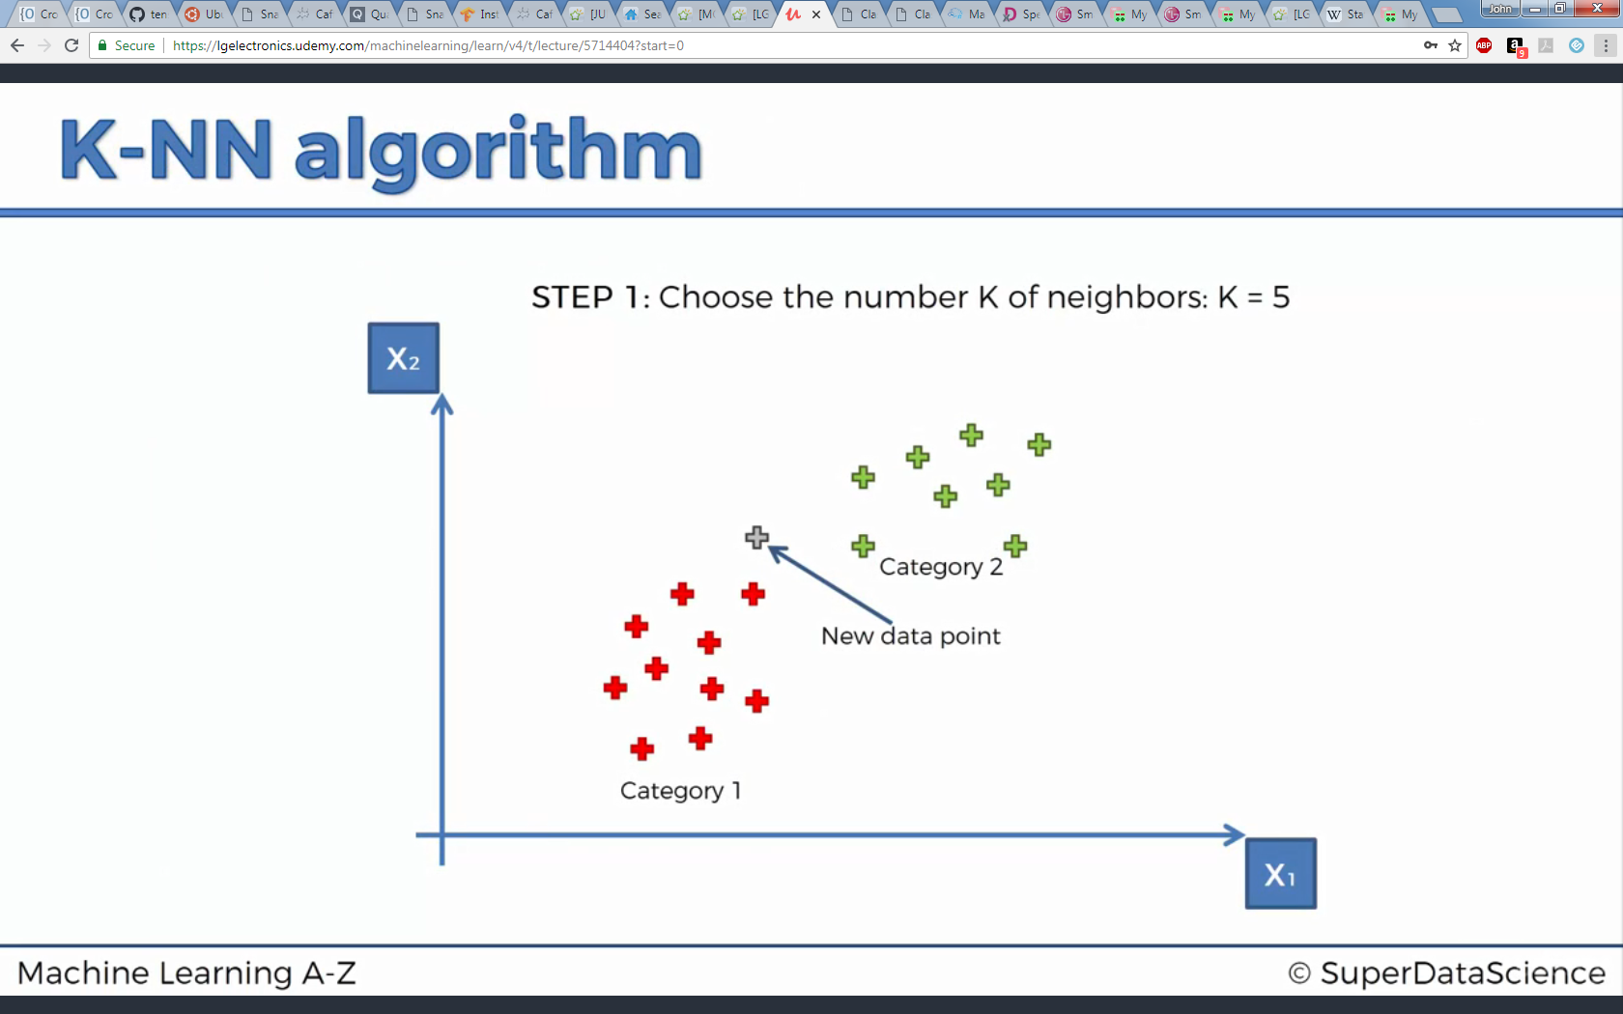
K-Nearest Neighbors (K-NN)

Slide 8
K-Nearest Neighbors (K-NN)
Step 1 : Choose the number K of neighbors
Step 2 : Take the K nearest neighbors of the new data point, according to the Euclidean distance
Step 3 : Among these K neighbors, count the number of data points in each category
Step 4 : Assign the new data point to the category where you counted the most neighbors

Slide 9
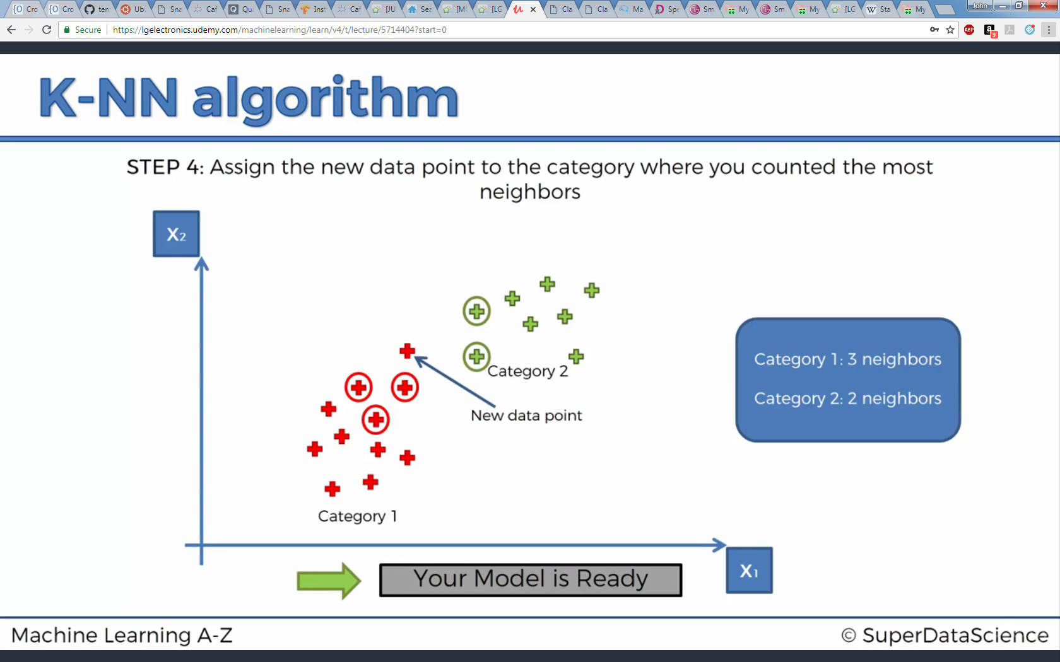
K-Nearest Neighbors (K-NN)
Step 1
K = 5
Step 2
Step 3
Step 4

Slide 10
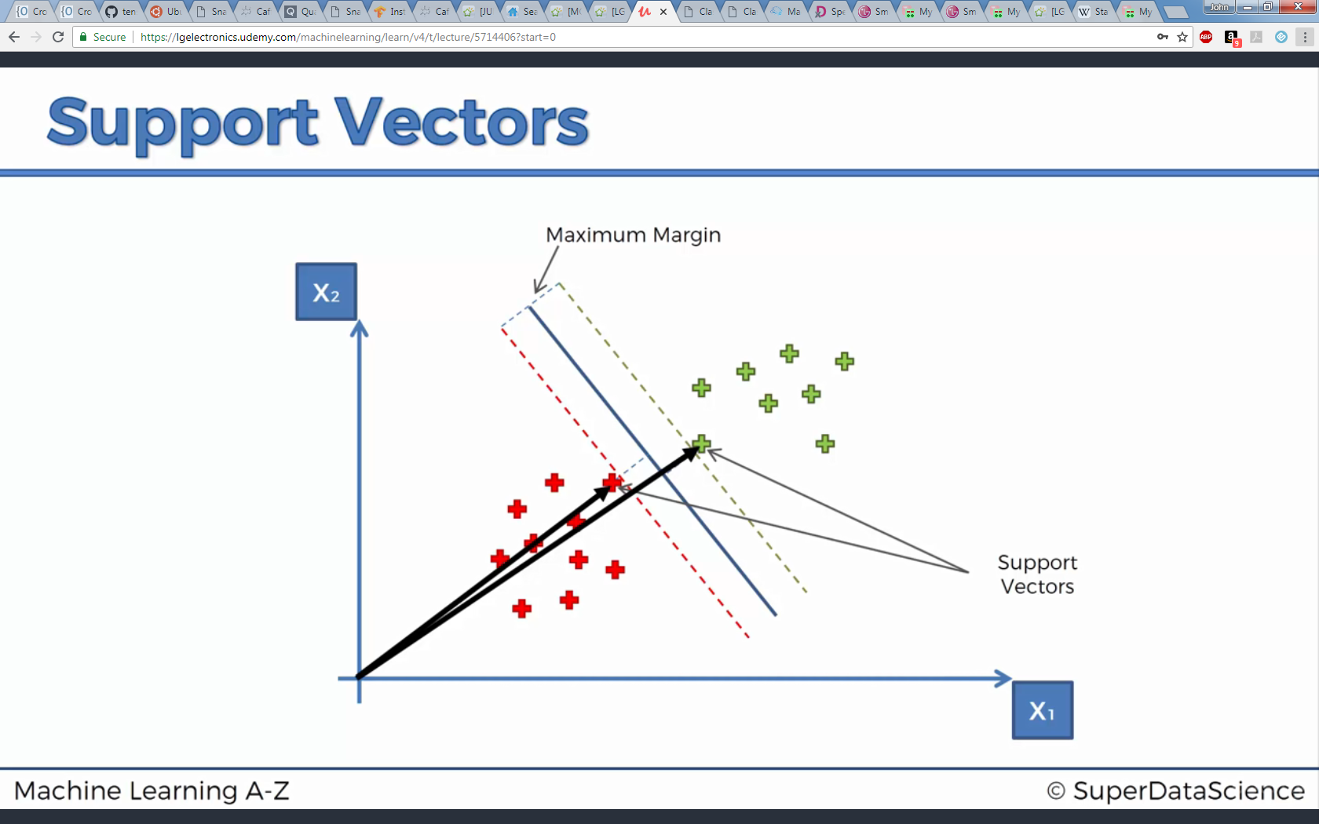
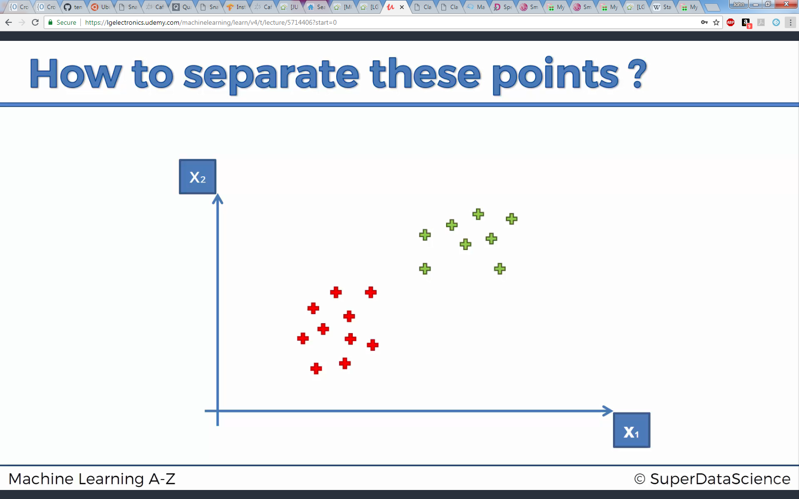
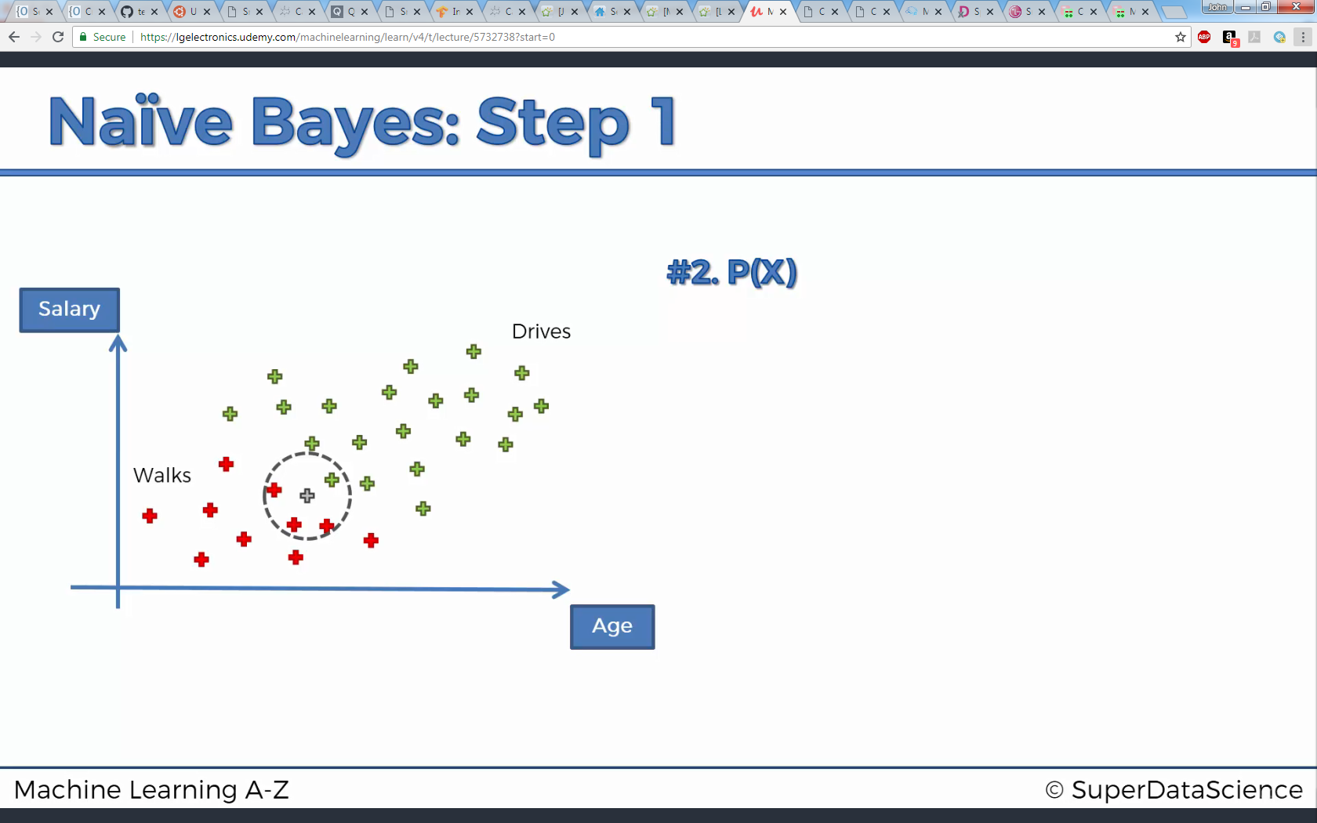
Support Vector Machine (SVM)
Separate categories with linear line

Slide 11
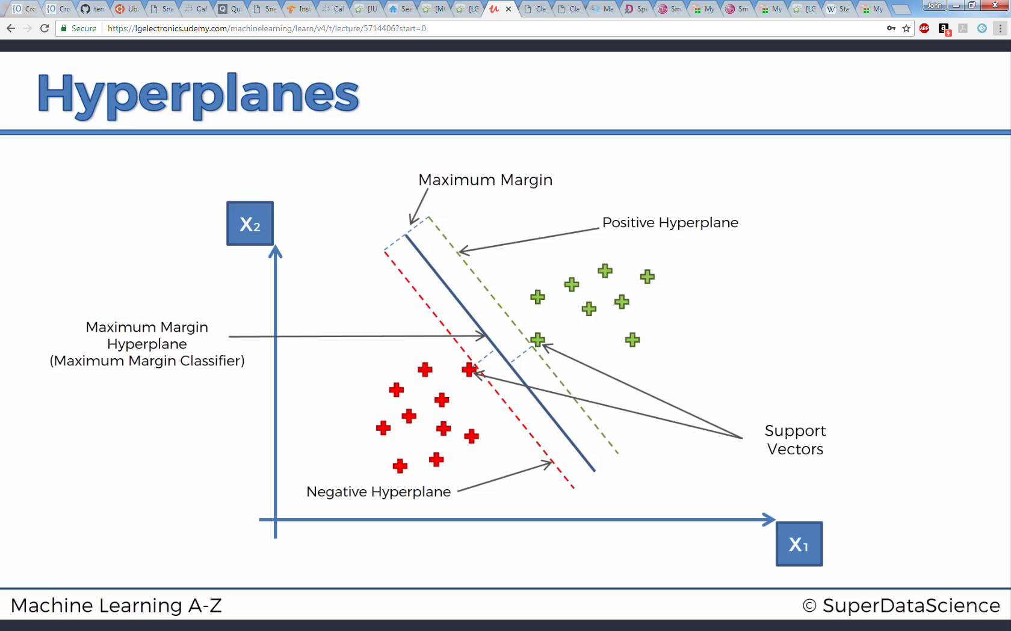
Support Vector Machine (SVM)

Slide 12
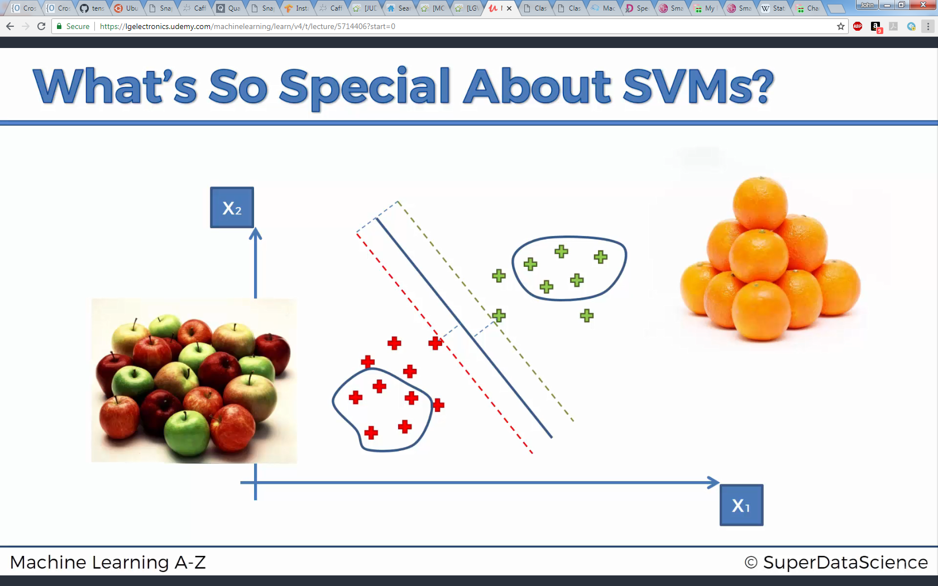
Support Vector Machine (SVM)

Slide 13
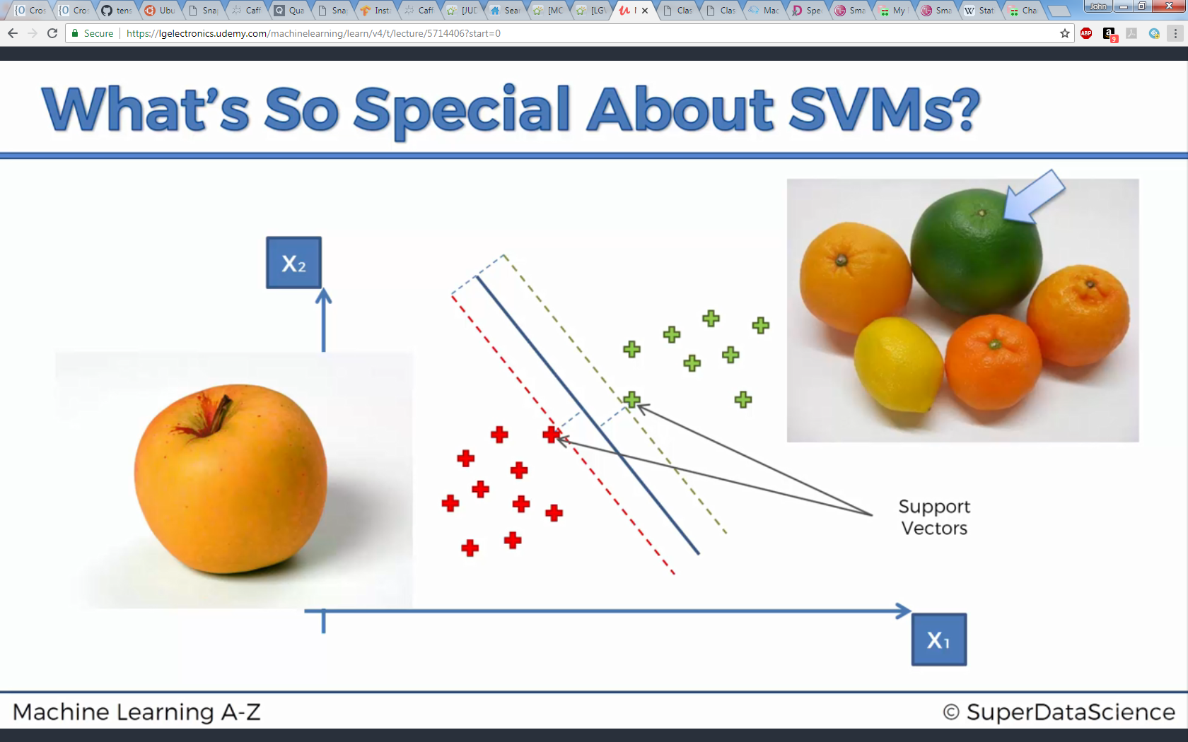
Support Vector Machine (SVM)

Slide 14
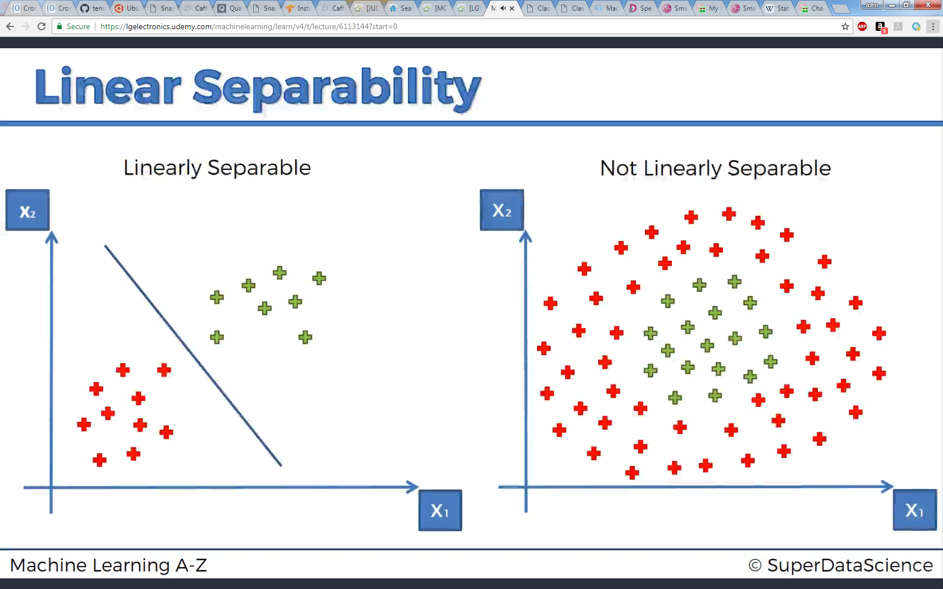
Kernel SVM
Categorizing data that aren’t linearly separable

Slide 15
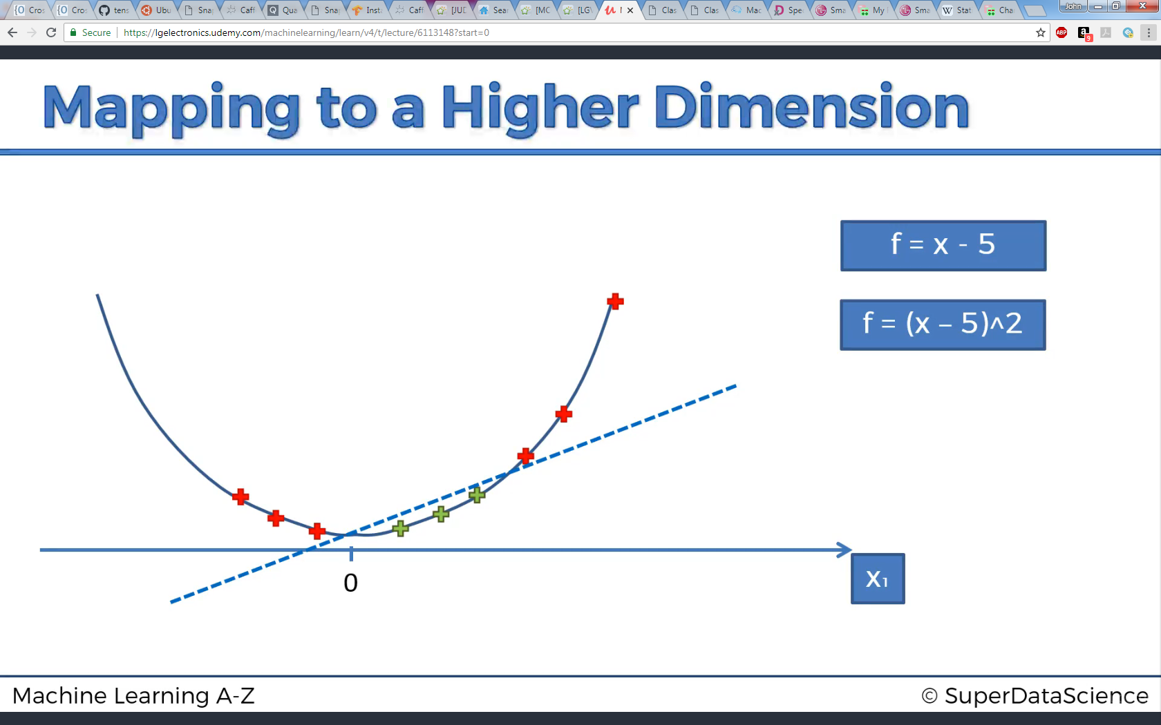
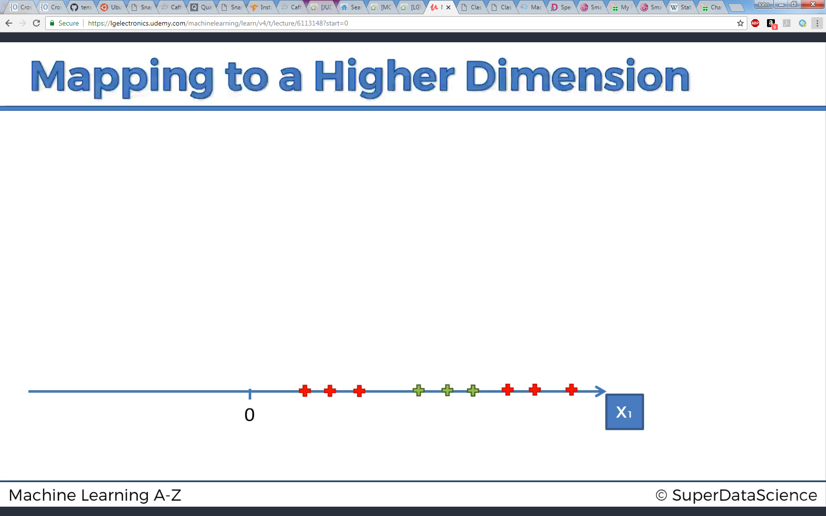
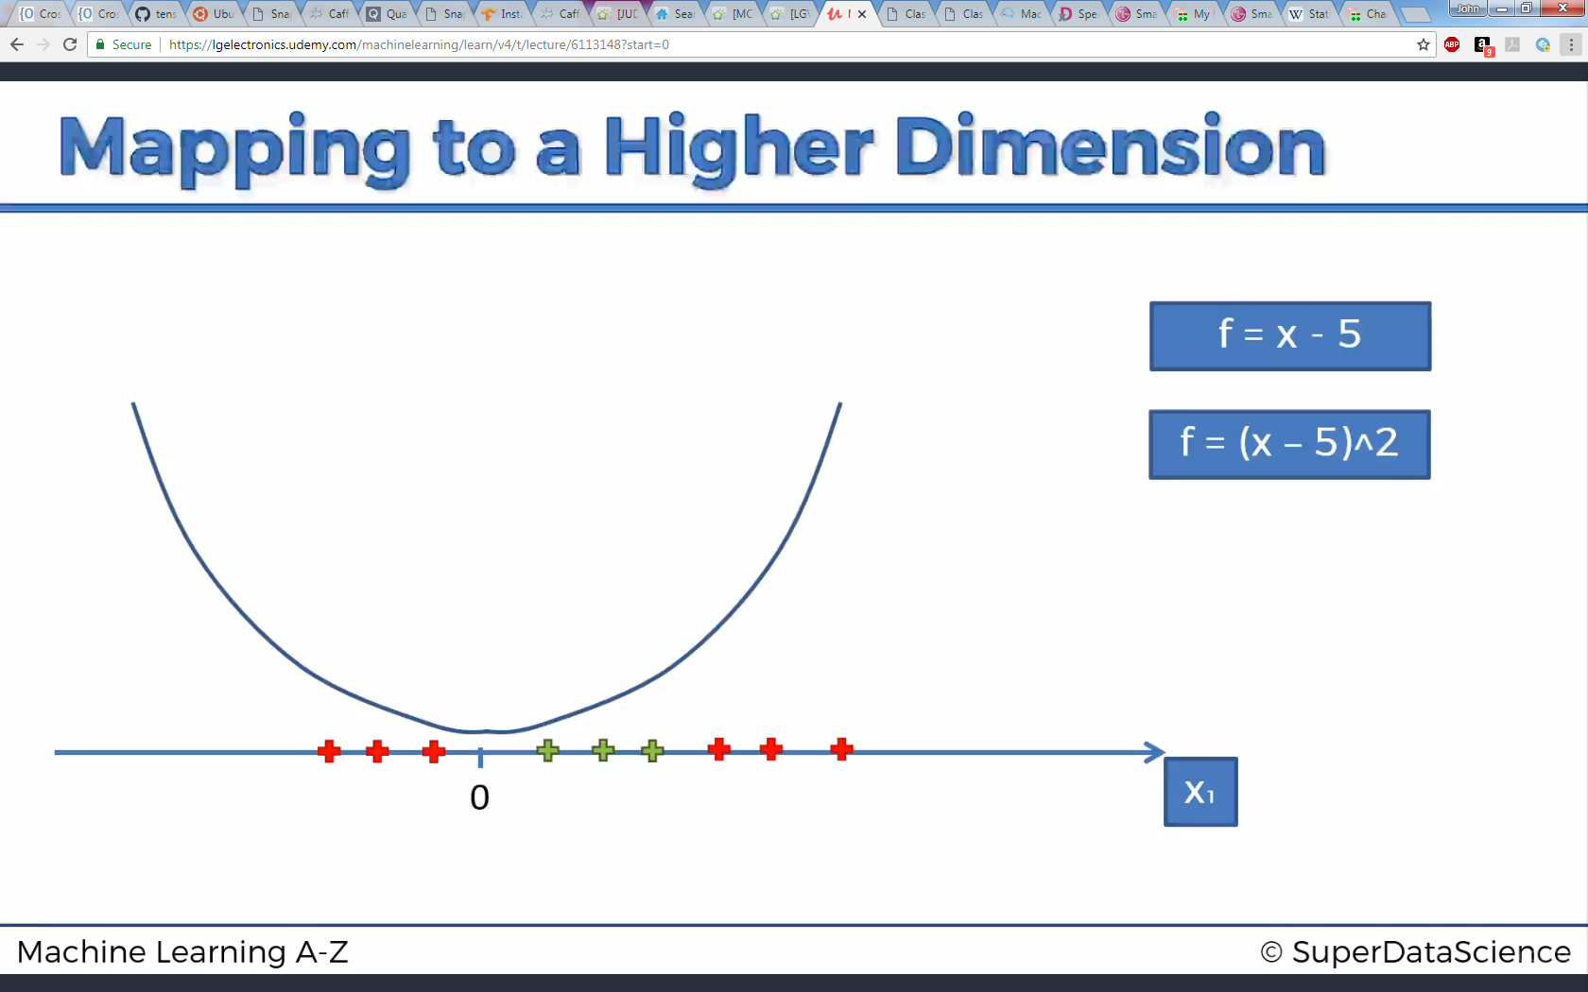
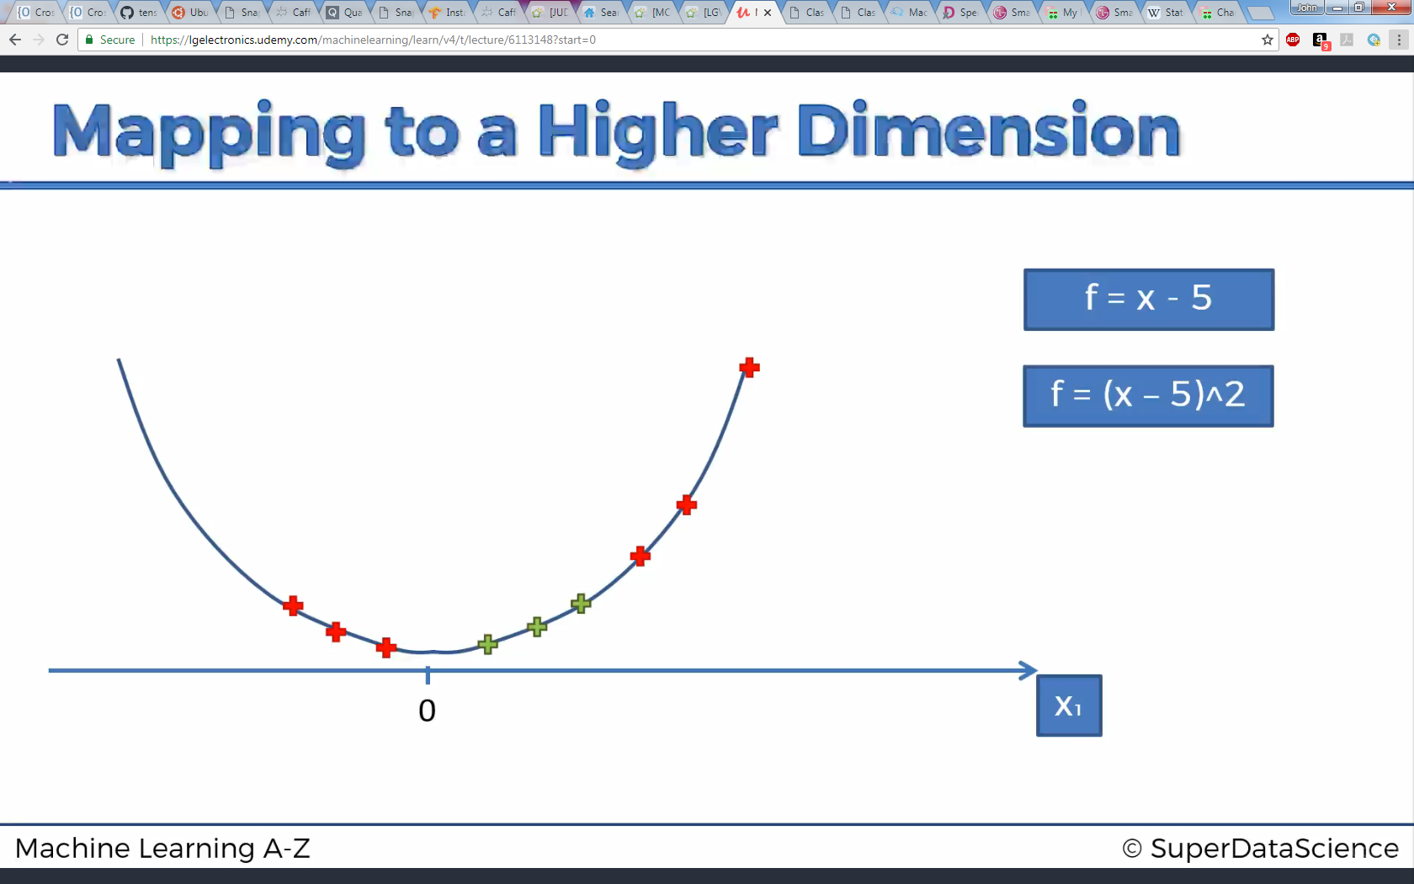
Kernel SVM
1-D to 2-D mapping example

Slide 16
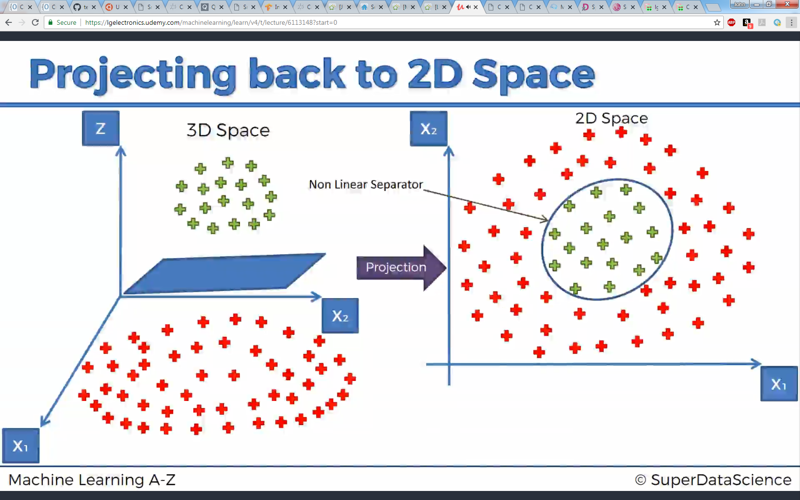
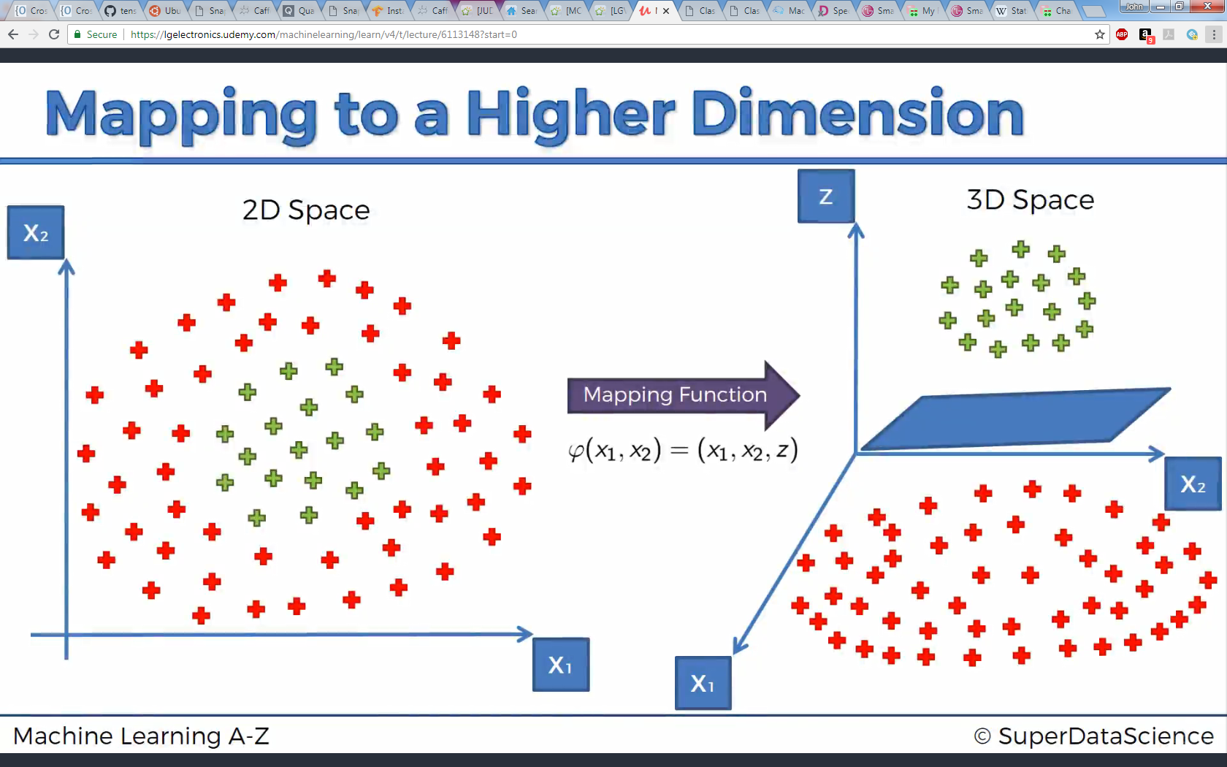
Kernel SVM
2D to 3D …

Slide 17
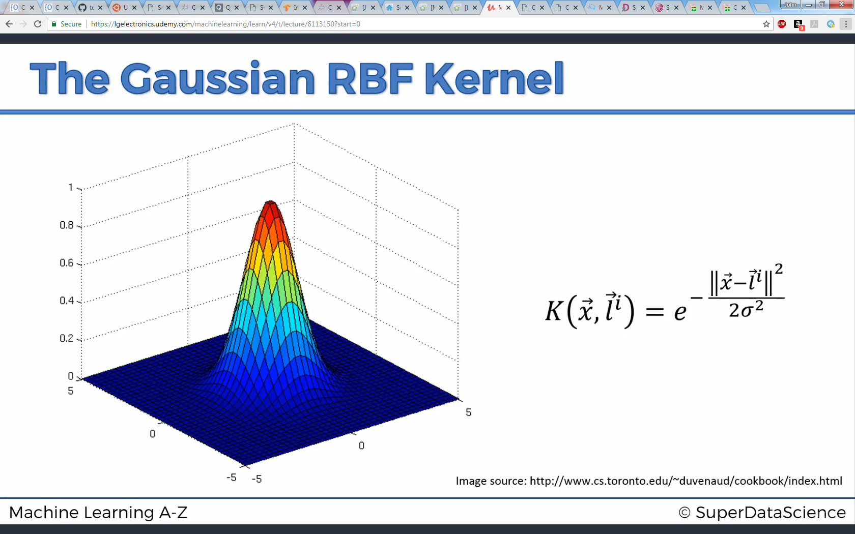
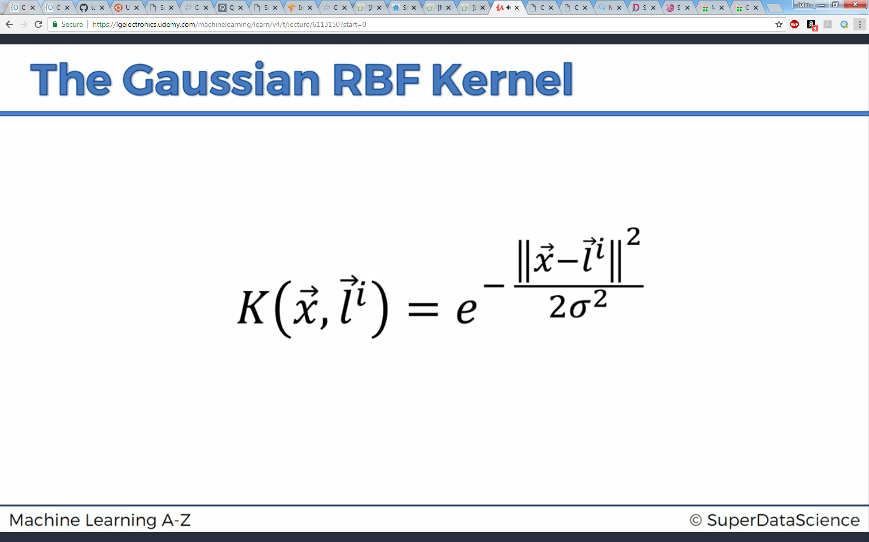
Kernel SVM
Kernel function

Slide 18
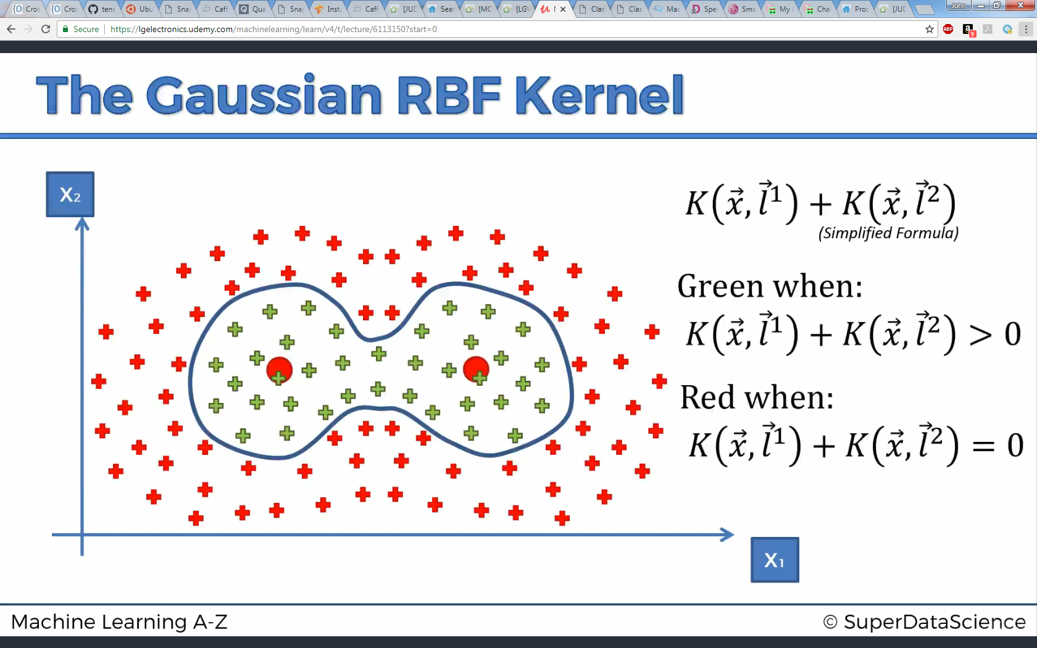
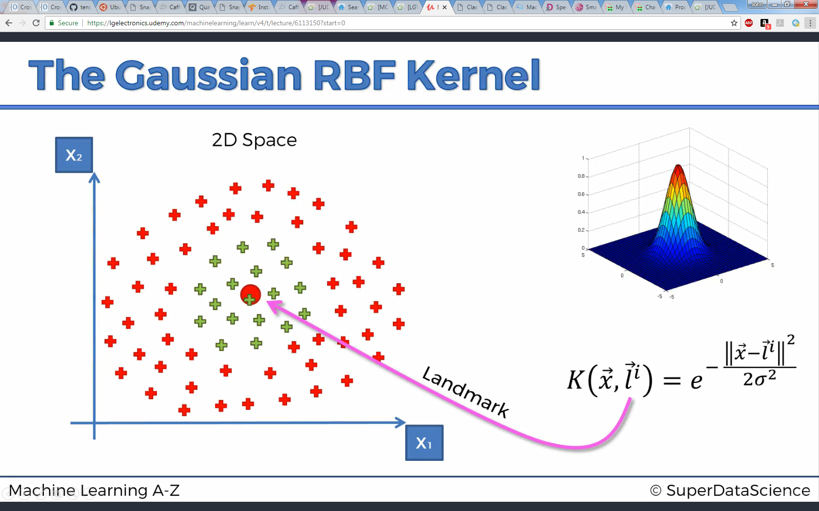
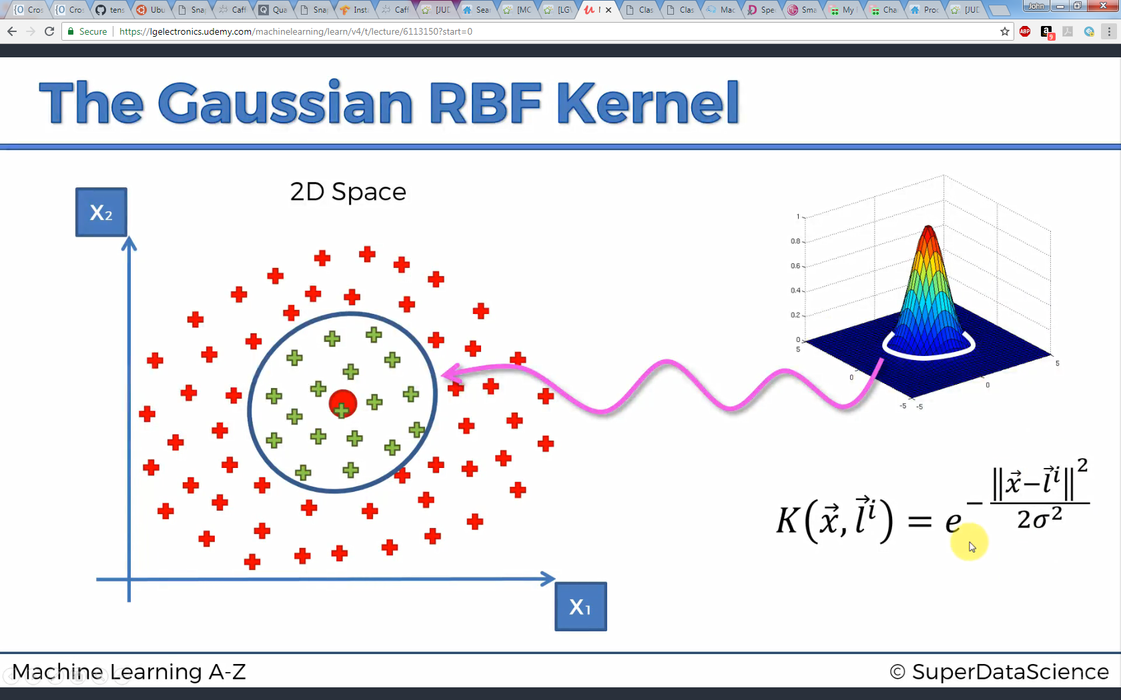
Kernel SVM

Slide 19
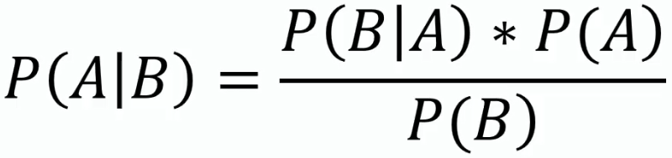
Naïve Bayes
Classification method based on Bayes Theorem of probability:
Likelihood
Prior Probabilty
Posterior Probabilty
Marginal Likelihood

Slide 20
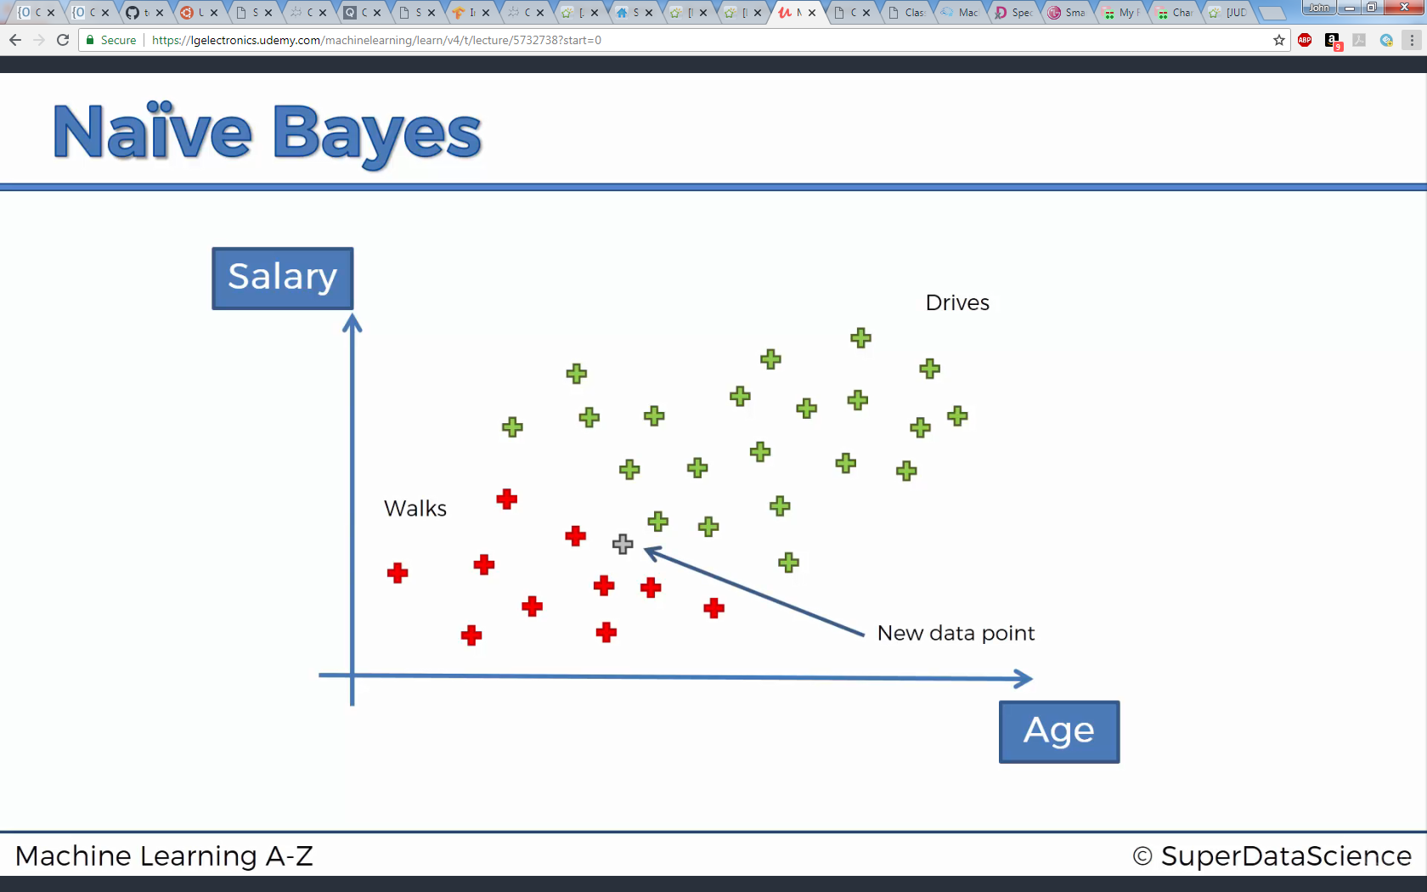

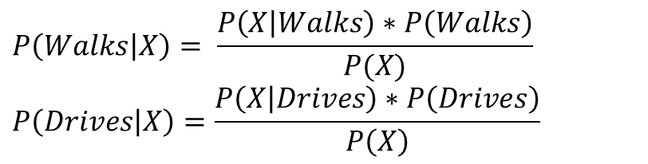
Naïve Bayes
Find and compare P(Walks|X) and P(Drives|X) – categorize to whichever returns higher probabilty
$$P\left(Walks | X\right)= \frac{P\left(X | Walks\right)∗P\left(Walks\right)}{P(X)}$$
$$P\left(Drives | X\right)=\frac{P\left(X | Drives\right)∗P\left(Drives\right)}{P\left(X\right)}$$

Slide 21
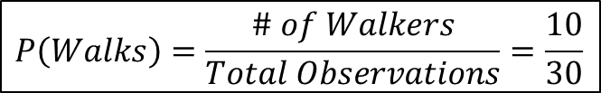
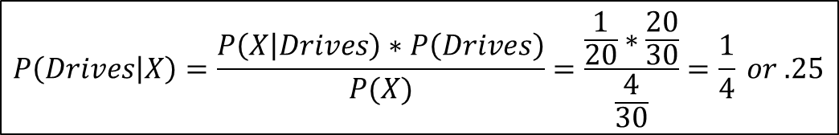
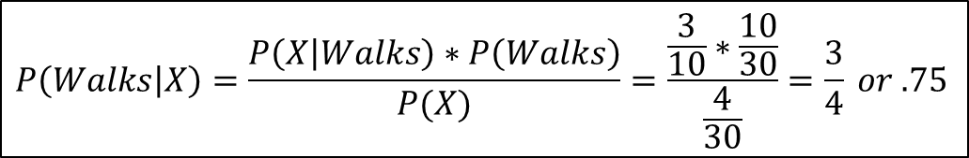
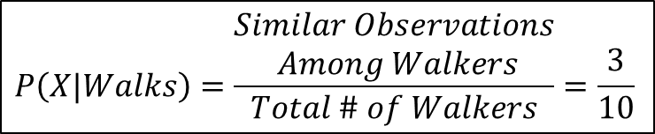
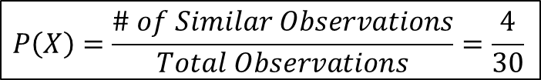
Naïve Bayes
$$P\left(Walks\right)=\frac{\# of Walkers}{Total Observations}=\frac{10}{30}$$
$$P\left(X\right)=\frac{\# of Similar Observations}{Total Observations}=\frac{4}{30}$$
$$P\left(X|Walks\right)=\frac{\begin{aligned}Similar Observations \\ Among Walkers\end{aligned}}{Total \# of Walkers}=\frac{3}{10}$$
$$P\left(Walks | X\right)=\frac{P\left(X | Walks\right)∗P\left(Walks\right)}{P(X)}=\frac{\frac{3}{10}∗\frac{10}{30}}{\frac{4}{30}}=\frac{3}{4} or .75$$
$$P\left(Drives | X\right)=\frac{P\left(X | Drives\right)∗P\left(Drives\right)}{P(X)}=\frac{\frac{1}{20}∗\frac{20}{30}}{\frac{4}{30}}=\frac{1}{4} or .25$$

Slide 22
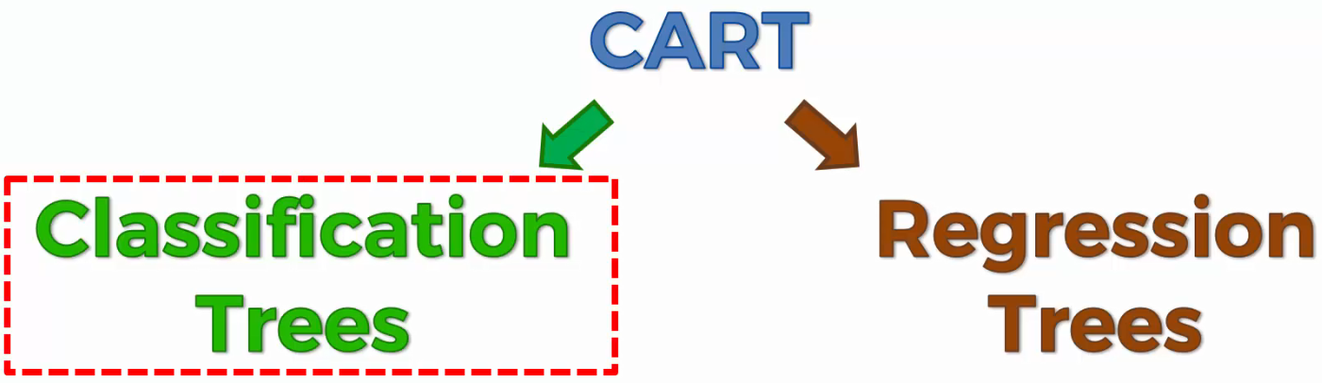
Decision Tree

Slide 23
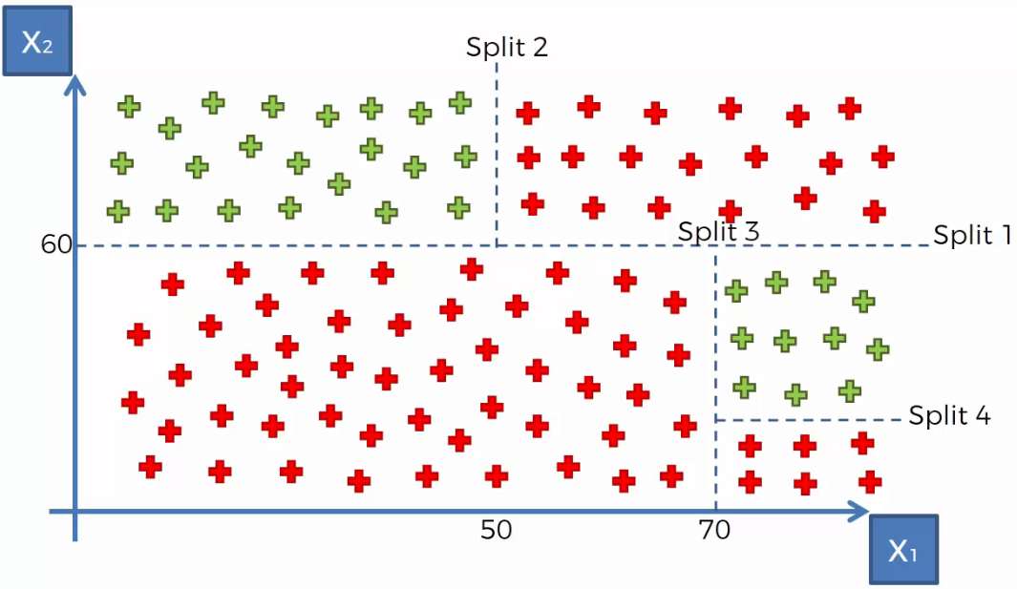
Decision Tree

Slide 24
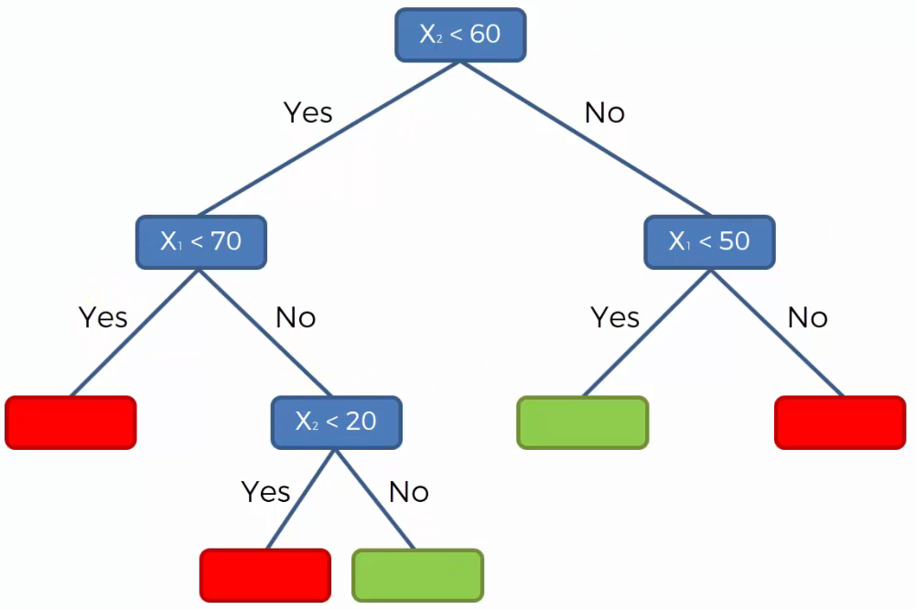
Decision Tree

Slide 25
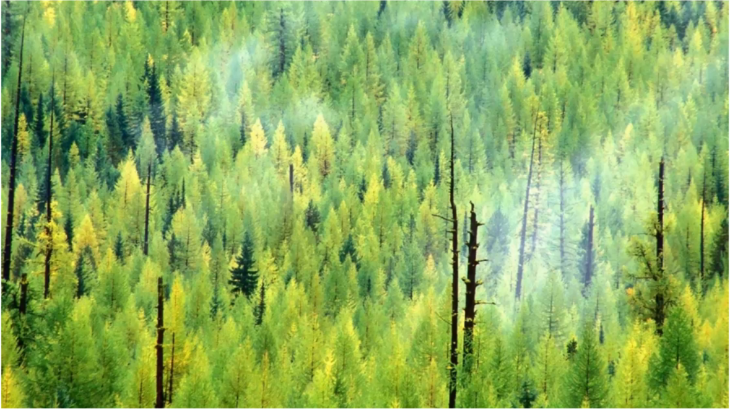
Random Forest
Ensemble Learning where combines multiple machine learning together into one bigger machine learning algorithm.

Slide 26
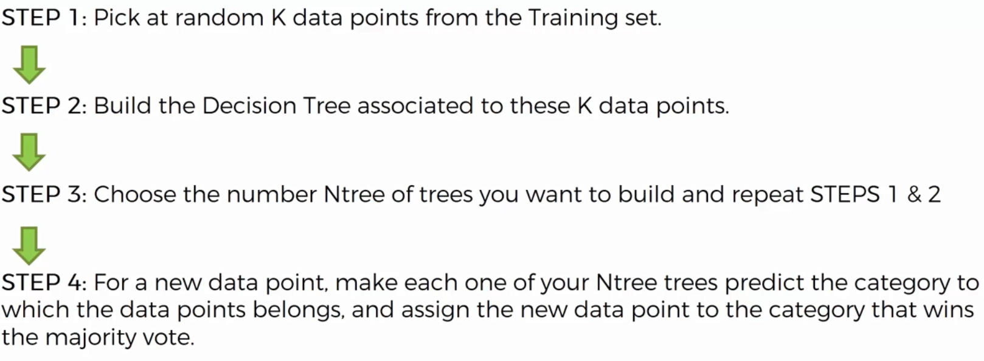
Random Forest

Slide 27
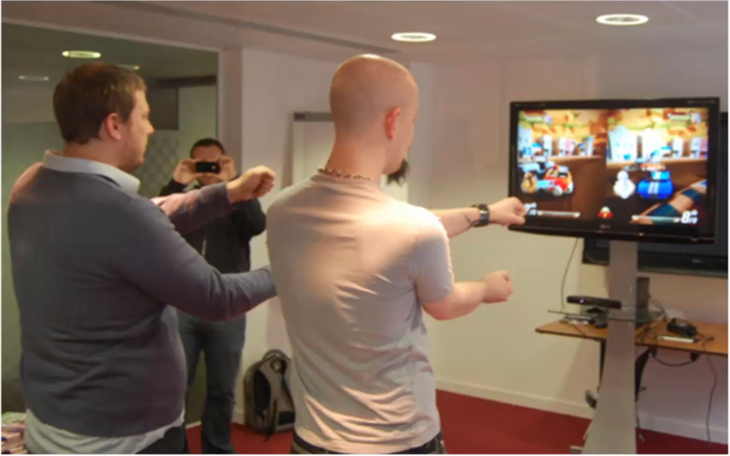
Random Forest

Slide 28
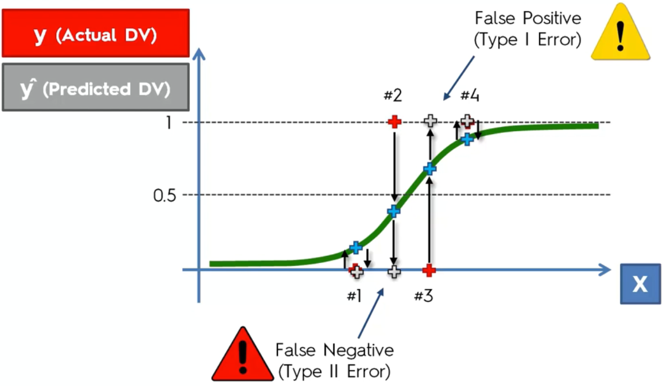
False Predictions

Slide 29
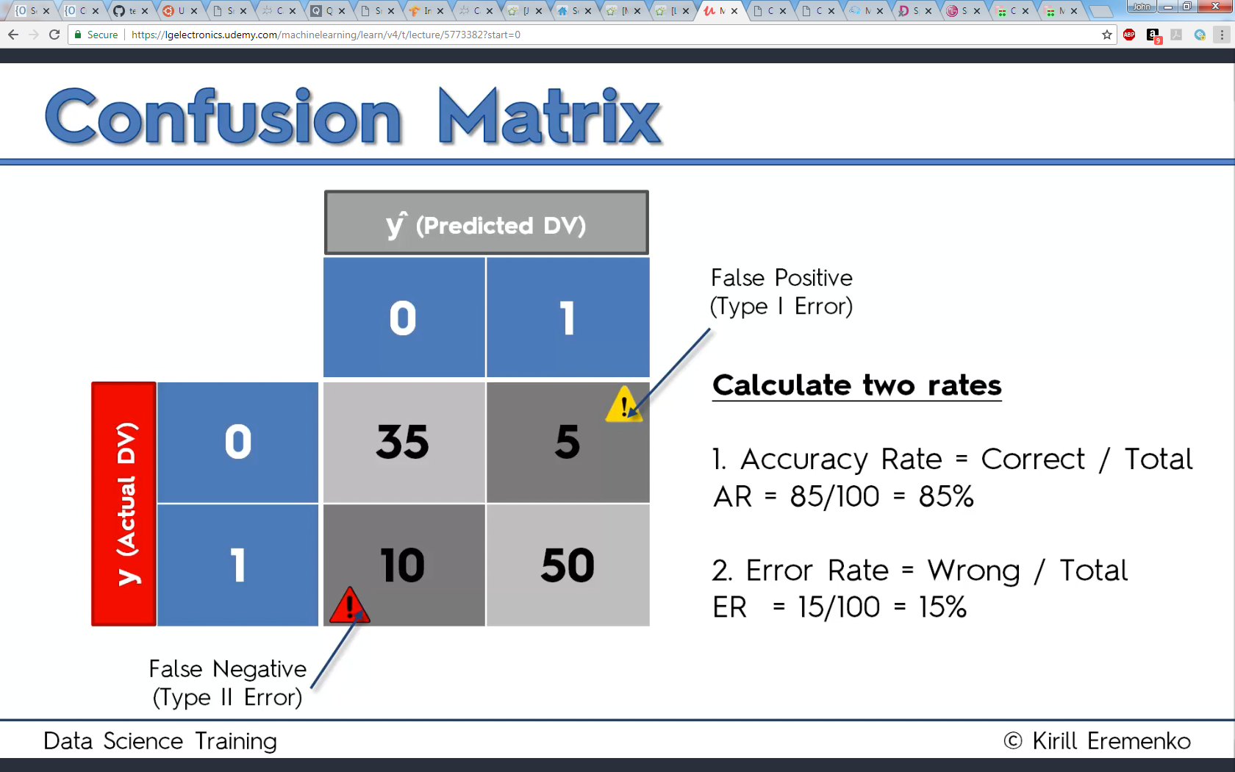
Confusion Matrix

Slide 30
Confusion Matrix
# Making the Confusion Matrix
from sklearn.metrics import confusion_matrix
cm = confusion_matrix(y_test, y_pred)

Slide 31
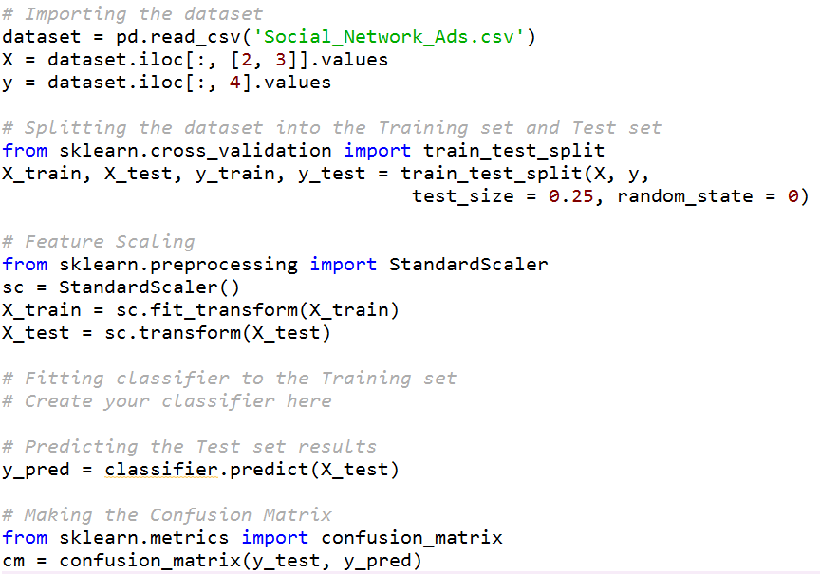
Classification Template

Slide 32
Classifiers
Logistic Regresion | from sklearn.linear_model import LogisticRegression classifier = LogisticRegression(random_state = 0)
K-Nearest Neighbors | from sklearn.neighbors import KNeighborsClassifier classifier = KNeighborsClassifier(n_neighbors = 5, metric = 'minkowski', p = 2)
SVM | from sklearn.svm import SVC classifier = SVC(kernel = 'linear', random_state = 0)
Kernel SVM | from sklearn.svm import SVC classifier = SVC(kernel = 'rbf', random_state = 0)
Naïve Bayes | from sklearn.naive_bayes import GaussianNB classifier = GaussianNB()
Decision Tree | from sklearn.tree import DecisionTreeClassifier classifier = DecisionTreeClassifier(criterion = 'entropy', random_state = 0)
Random Forest | from sklearn.ensemble import RandomForestClassifier classifier = RandomForestClassifier(n_estimators = 10, criterion = 'entropy', random_state = 0)

Slide 33
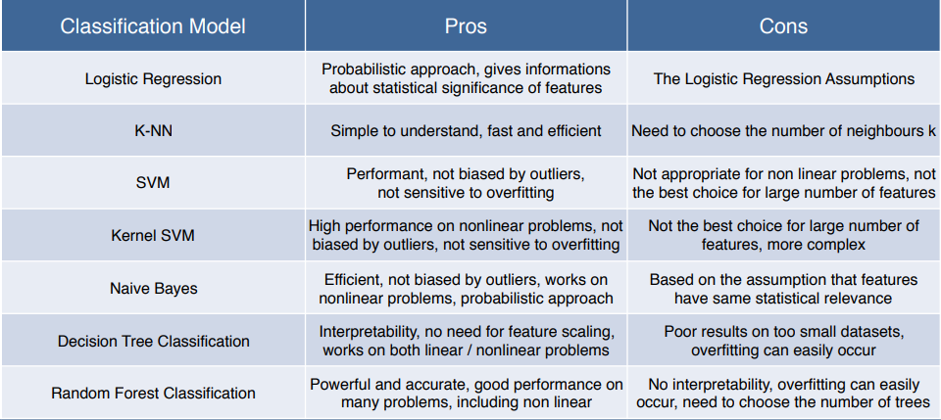
Classification Models

Slide 34
Which Classification Model to Use
Figure out whether the problem is linear or non linear
If the problem is linear, use Logistic Regression or SVM
If the problem is non linear, use K-NN, Naive Bayes, Decision Tree or Random Forest

Slide 35
Which Classification Model to Use
Use Logistic Regression or Naive Bayes when you want to rank your predictions by their probability - rank your customers from the highest probability that they buy a certain product, to the lowest probability
Use SVM when you want to predict to which segment your customers belong to

Slide 36
Which Classification Model to Use
Decision Tree when you want to have clear interpretation of your model results
Random Forest when you are just looking for high performance with less need for interpretation

